Slide 1
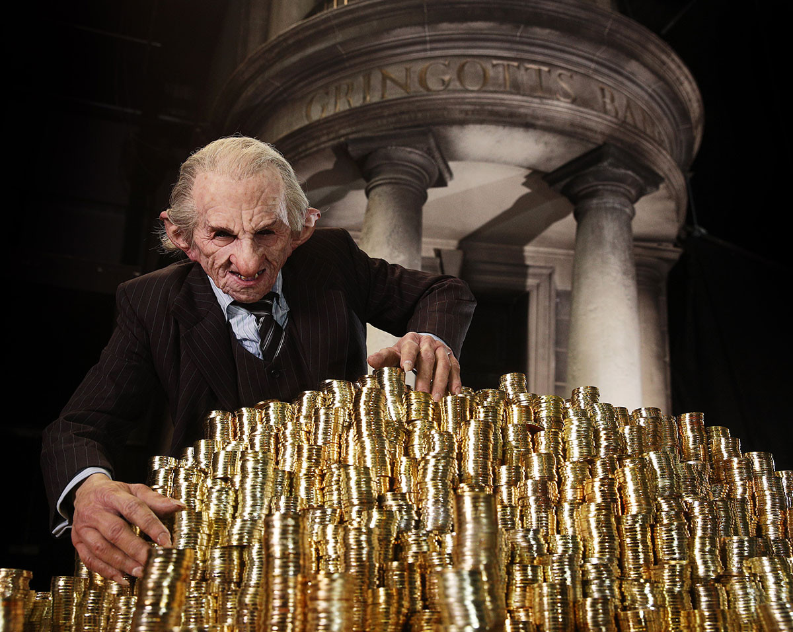
Better Understanding Our Customers – Who accepts Credit Card Offers ?
Lily Potter
Andrea, Tony, Jerrit

Slide 2
Intro
Project steps
Setup Tools
Tasks and responsibilities
Work
Update repo
Tools we used

Slide 3



Business Question
What
What are the variables and characteristics that influence customer decision?
Who will accept a credit card offer?
Why
Making Sales aware of how a profitable lead is characterized
Targeting marketing efforts on customers who are likely to accept our offers
How
Development of a machine learning model to predict customer behaviour
Heatmap of characteristics, qualitative analysis

Slide 4



Process
Our Database and Results from Marketing
Cleaning, Wrangling, EDA,
Pre-processing, Predictions
Preparing graphs and results for management
Extract to .csv and import to tableau
Extraction with SQL

Slide 5
Iterations
Logistic regression
Oversampling
Hybrid
Random forest
Undersampling
acu: 71 %
acu: 94 %
acu: 73 %
acu: 94 %
acu: 69 %
Sampling
Model

Slide 6
Results & Next steps
We can target potential credit card users with an accuracy of approx. 87 %
Next steps
Transfer the developed method into business processes for marketing:
Automatizing data processing from DB to CRM
Live dashboards for marketing users
Training staff
Characteristics of potential credit card user
Preferred Reward – “Air Miles”
Homeowner
Income Level low – medium
1-2 accounts with no overdraft protection

Slide 7
Thank You!

Slide 8
Process
5th
hybrid: Smote, Tomek, dropping Q1, Q2, Q3, Q4
73% accuracy score
1st No sampling technique. 94% but no positive
4th Drop columns (no of bank accounts)
71% accuracy score
2nd
SMOTE sampling technique 72% accuracy score
3rd
random oversampling
69 % accuracy

Slide 9

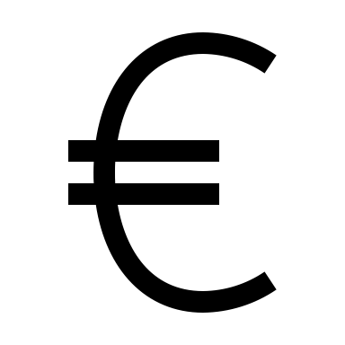


Increasing Revenue with Machine Learning
0,5
„yes“: 10 € per credit card x 0,5 = 5 €
-1 €
Without ML
1
4 €
„no“
*per marketing activity on a customer
0,5
$$\frac{0,89}{0,89+0,15}=0,86$$
„yes“: 10€ per credit card x 0,86 = 8,6 €
ML
-1 €
1
7,6 €
*per marketing activity on a customer
„no“:
$$\frac{0,15}{0,89+0,15}=0,14$$

